Slide 1
Graphs
CS 236
Fall 2023

Slide 2
Overview and Due
Topics:
Graph terminology
Graph definitions
Graph properties
Due
Project 3 due Thursday, Nov 9

Slide 3
Why Graphs?

Slide 4
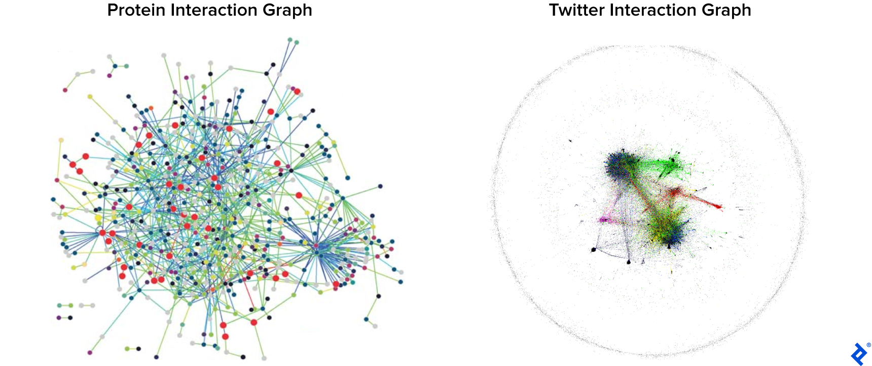
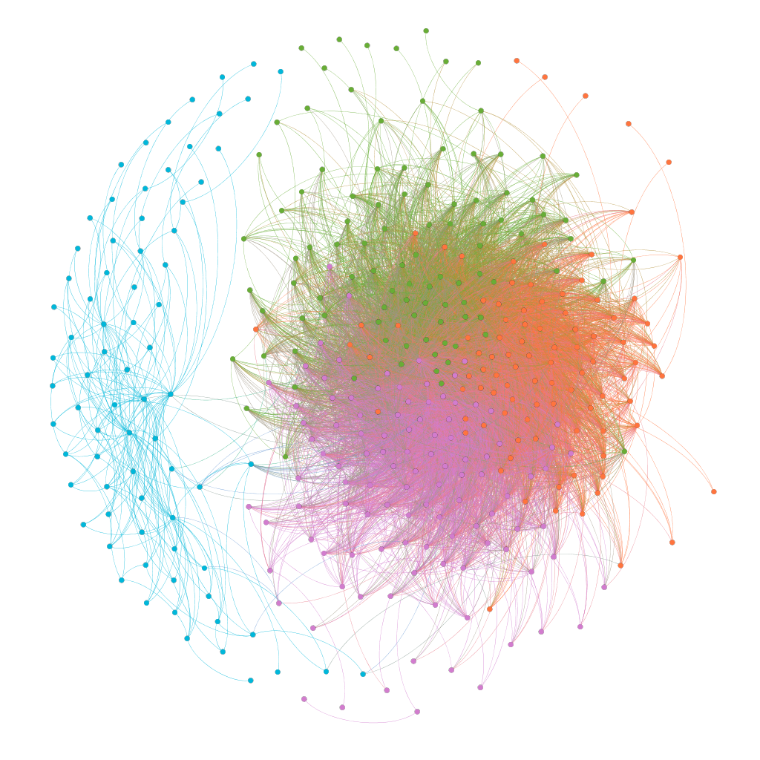
Graphs represent many interesting problems
and lend themselves to some cool algorithms
Graphs allow us to represent relations (and other data) that shows connections
There are many efficient algorithms that run on graphs
This allows us to solve many different problems
Goodrich uses graphs almost daily in his lab
Python example
https://www.toptal.com/data-science/graph-data-science-python-networkx
Notes:
Left image credit: TITZ, Björn, et al. “The Binary Protein Interactome of Treponema Pallidum …” PLoS One, 3, no. 5 (2008). Right image credit: ALBANESE, Federico, et al. “Predicting Shifting Individuals Using Text Mining and Graph Machine Learning on Twitter.” (August 24, 2020): arXiv:2008.10749 [cs.SI]

Slide 5
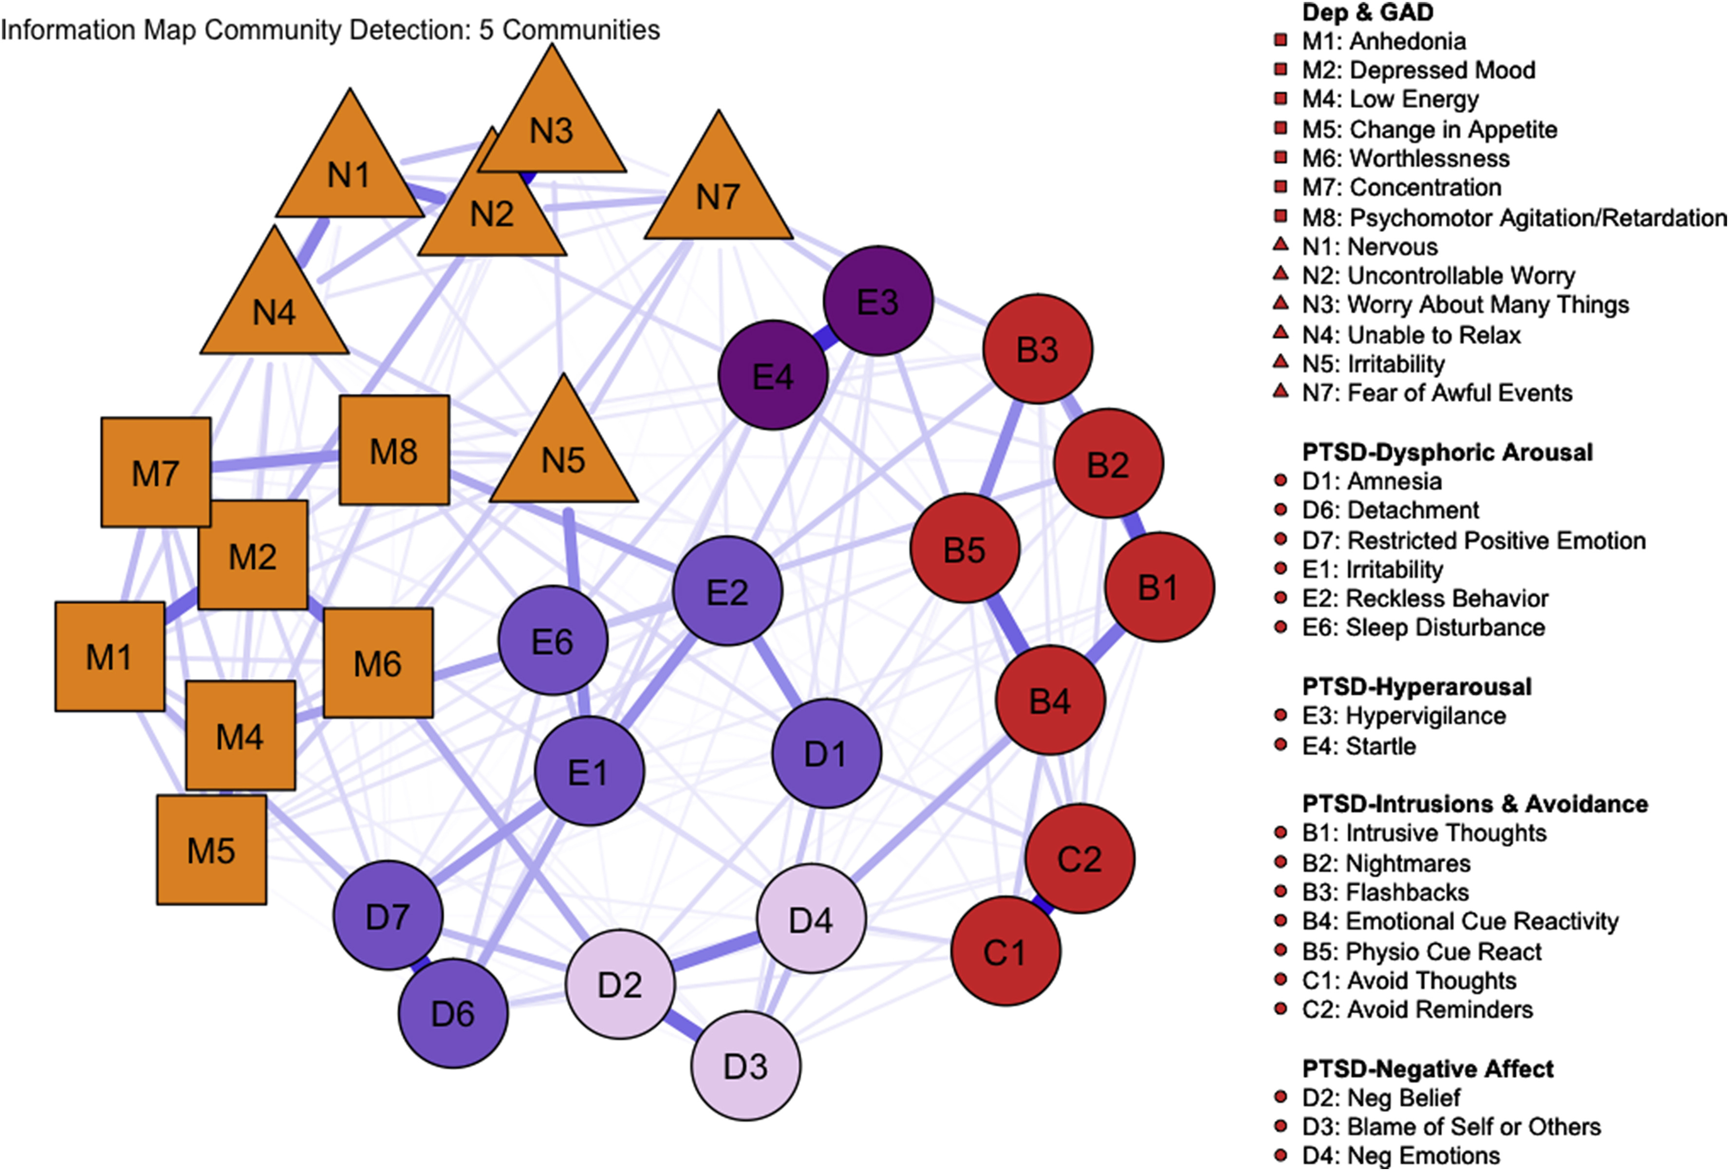
Clusters of symptoms representing GAD,
MDD, two manifestations of PTSD
https://www.sciencedirect.com/science/article/pii/S0022395618307088?casa_token=Ilsm7y1porAAAAAA:Xtr4b9316ENNFru7gd9-QVl8zVxdKduHzdim4oMB0vRCTuAC1A5PwjiAKLBIunGY3GTaNborJw
Notes:
Matthew Price, Alison C. Legrand, Zoe M.F. Brier, Laurent Hébert-Dufresne,
The symptoms at the center: Examining the comorbidity of posttraumatic stress disorder, generalized anxiety disorder, and depression with network analysis,
Journal of Psychiatric Research,
Volume 109,
2019,
Pages 52-58,
ISSN 0022-3956,
https://doi.org/10.1016/j.jpsychires.2018.11.016.

Slide 6
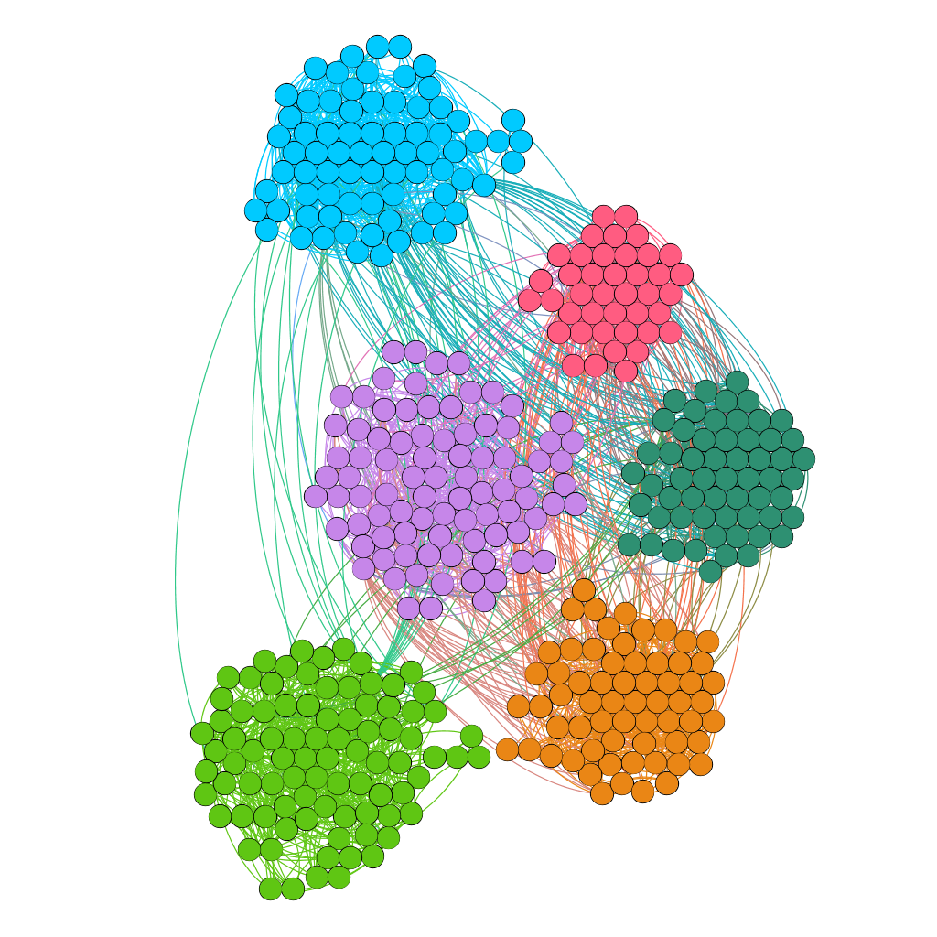
Who interacted with whom at a
conference in Dublin

Slide 7
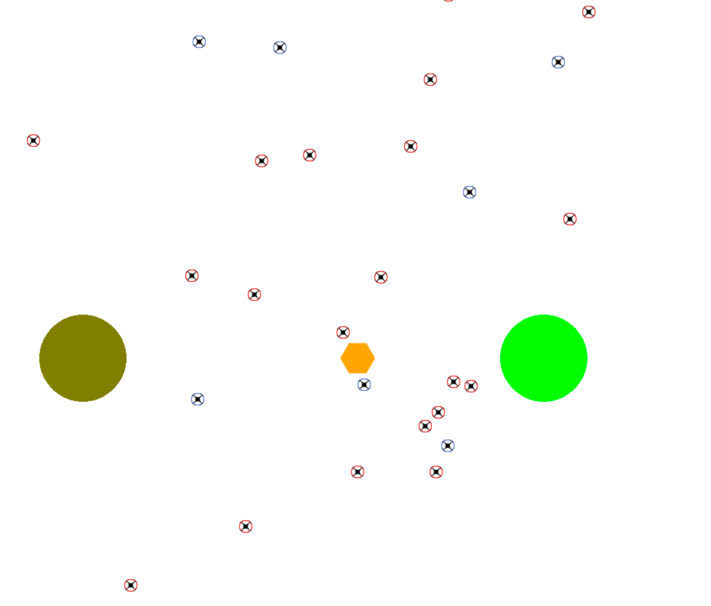
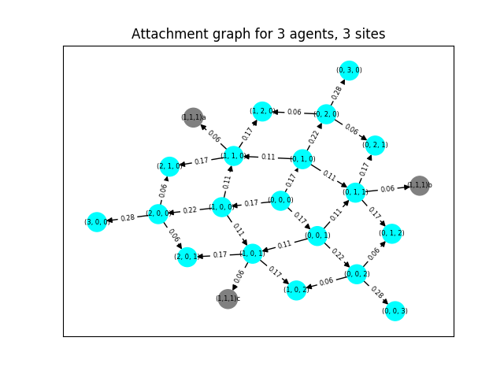
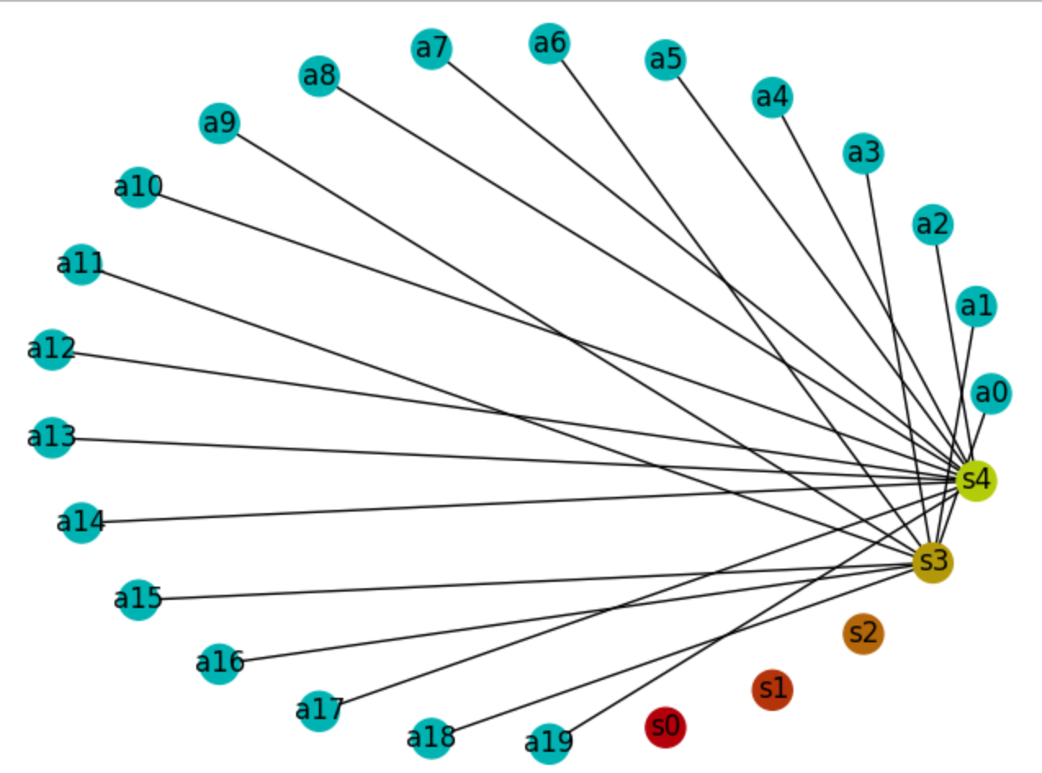
Graphs in my lab – one example
Agent-based Best of N solution
Bipartite graph model of collective agent state
Discrete time Markov chain graph dynamics

Slide 8
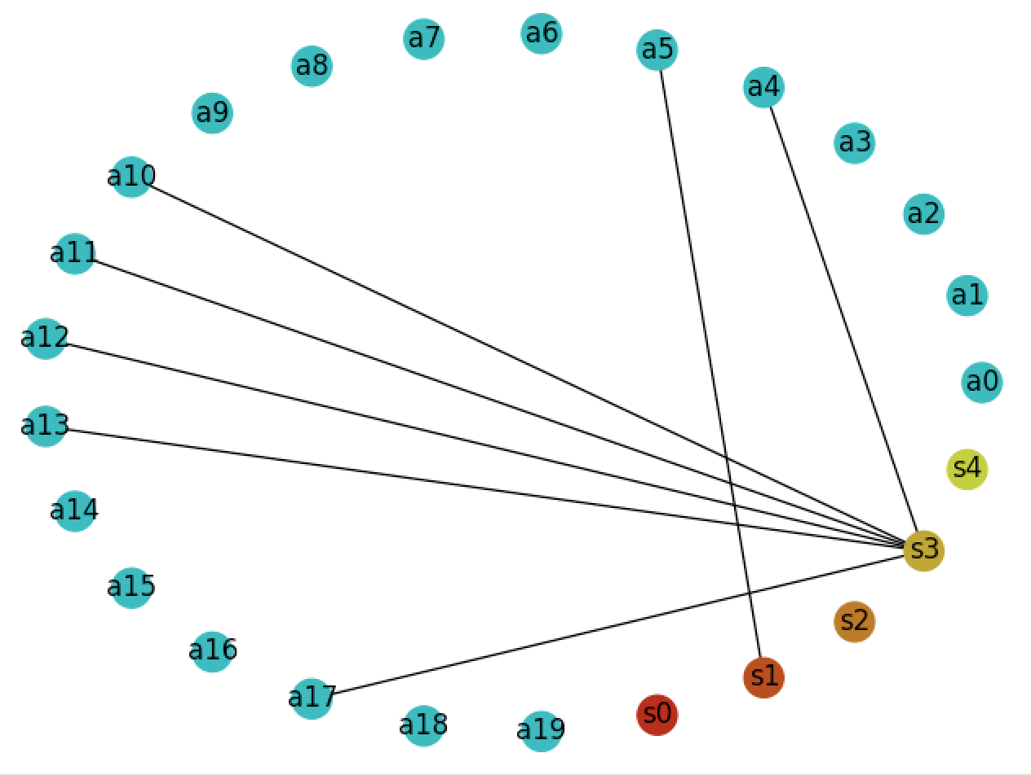
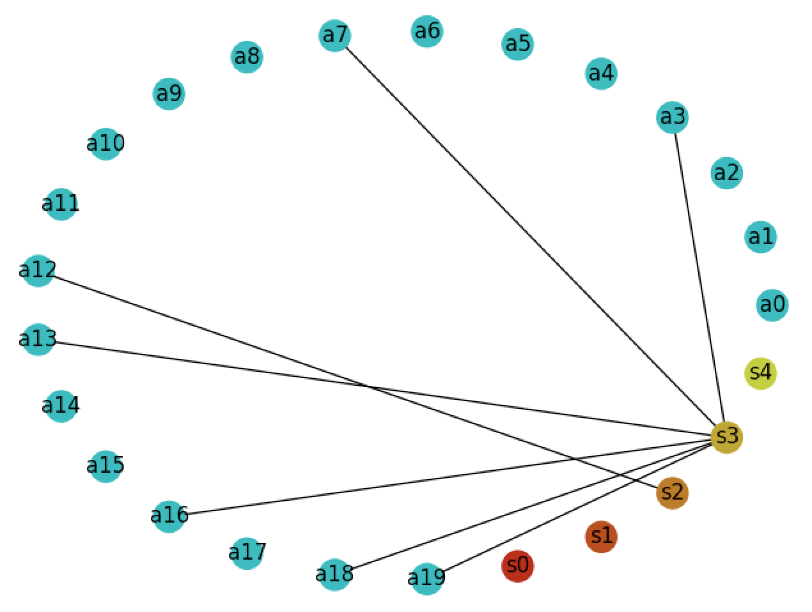
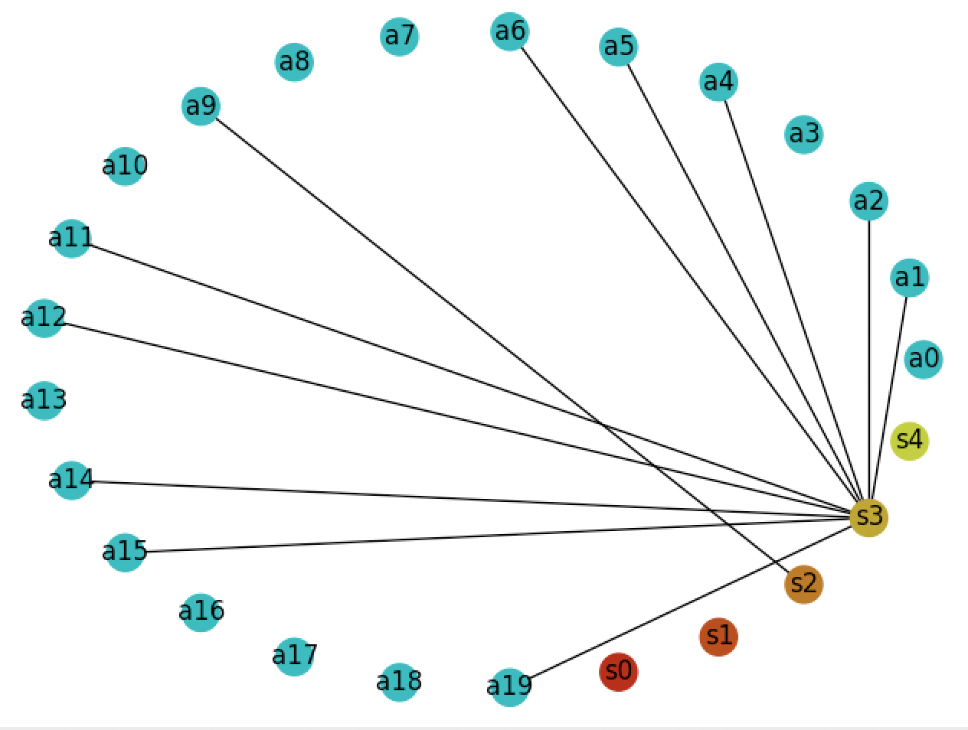
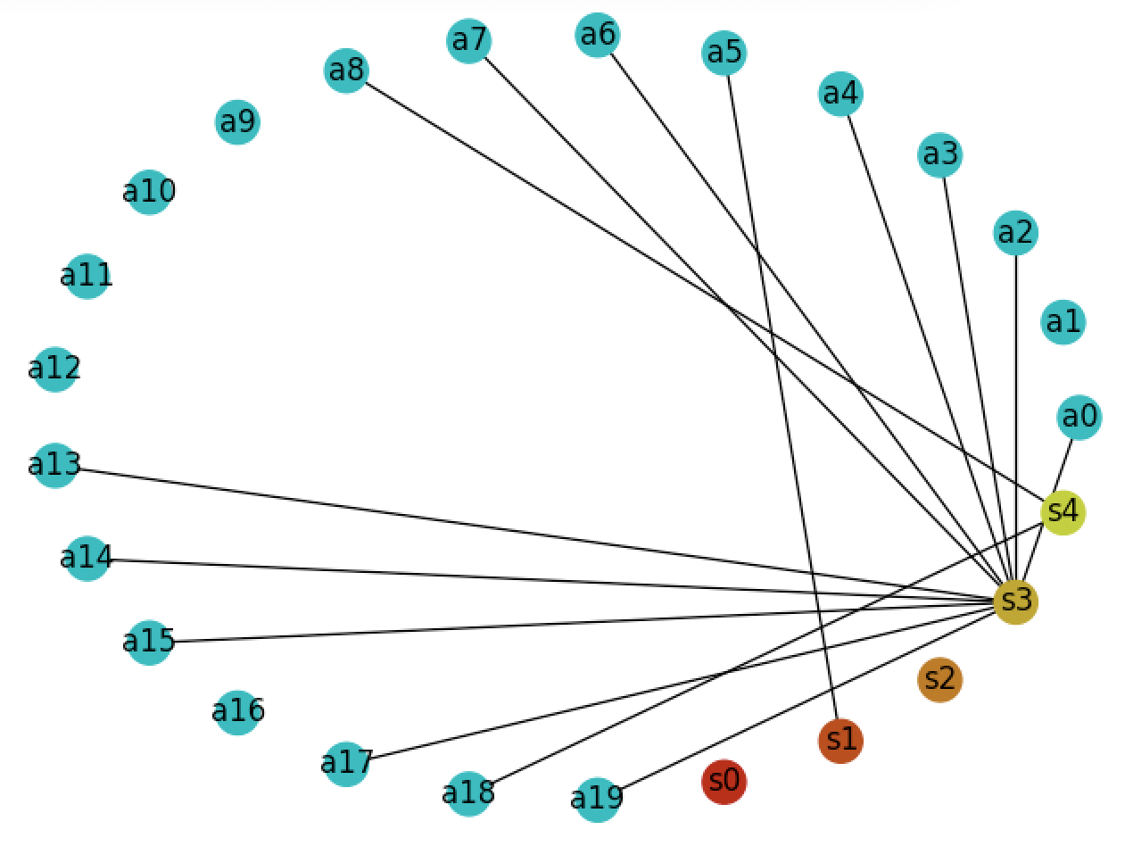
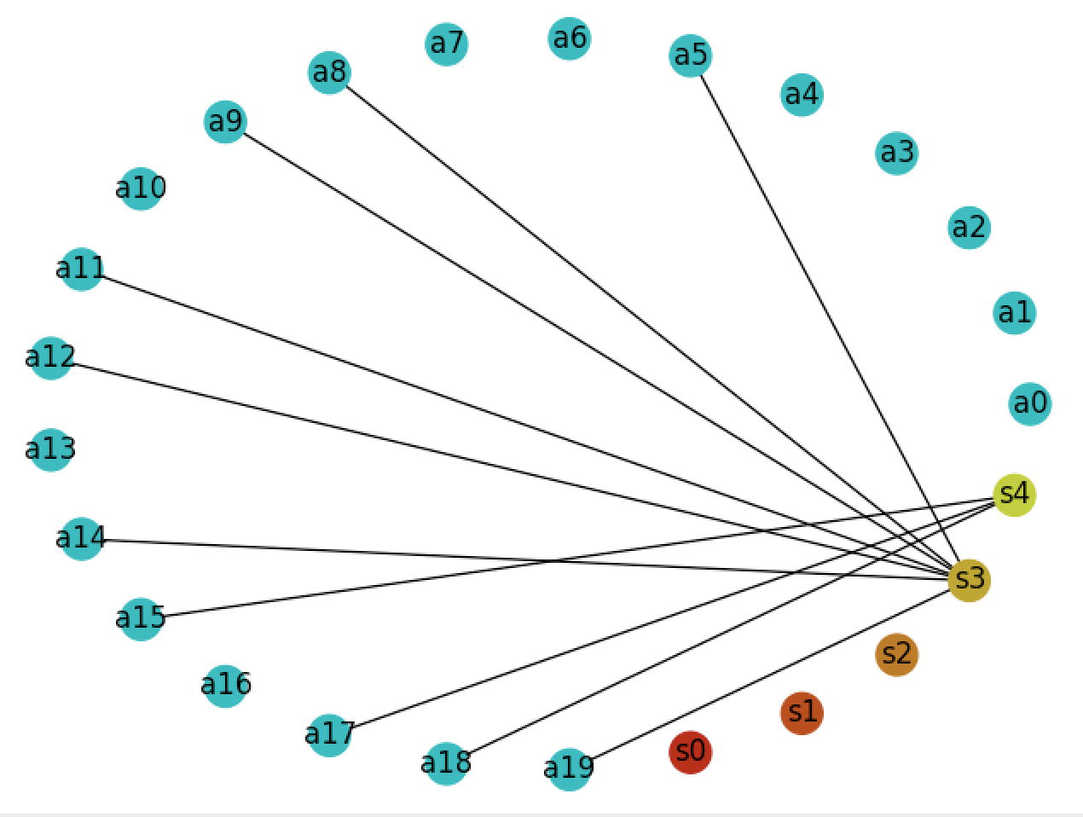
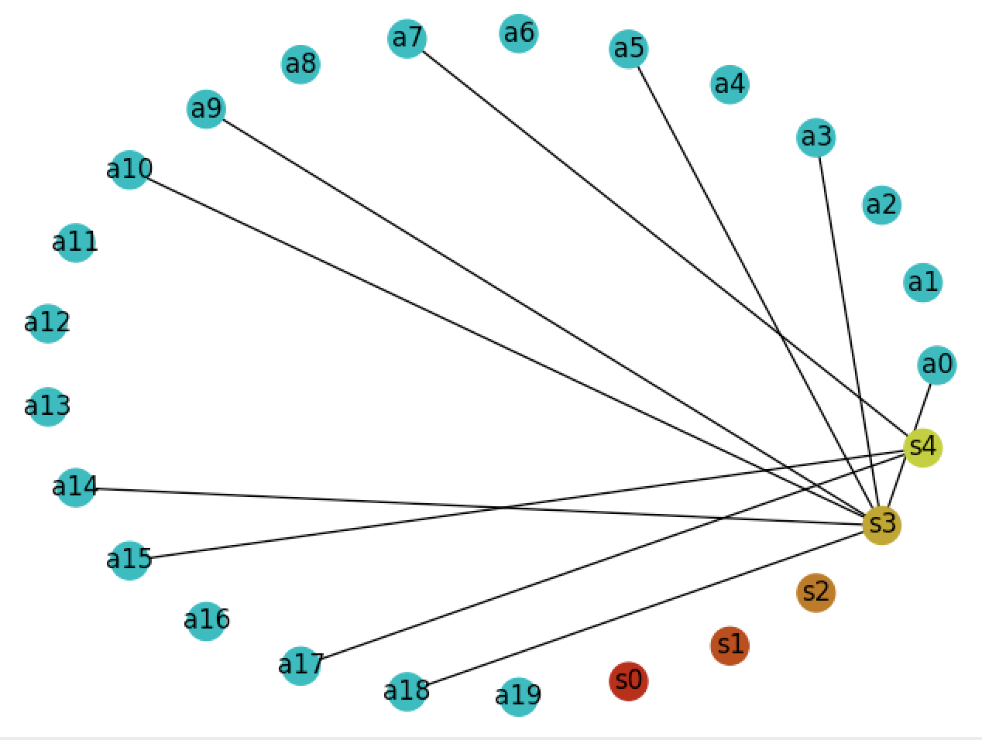
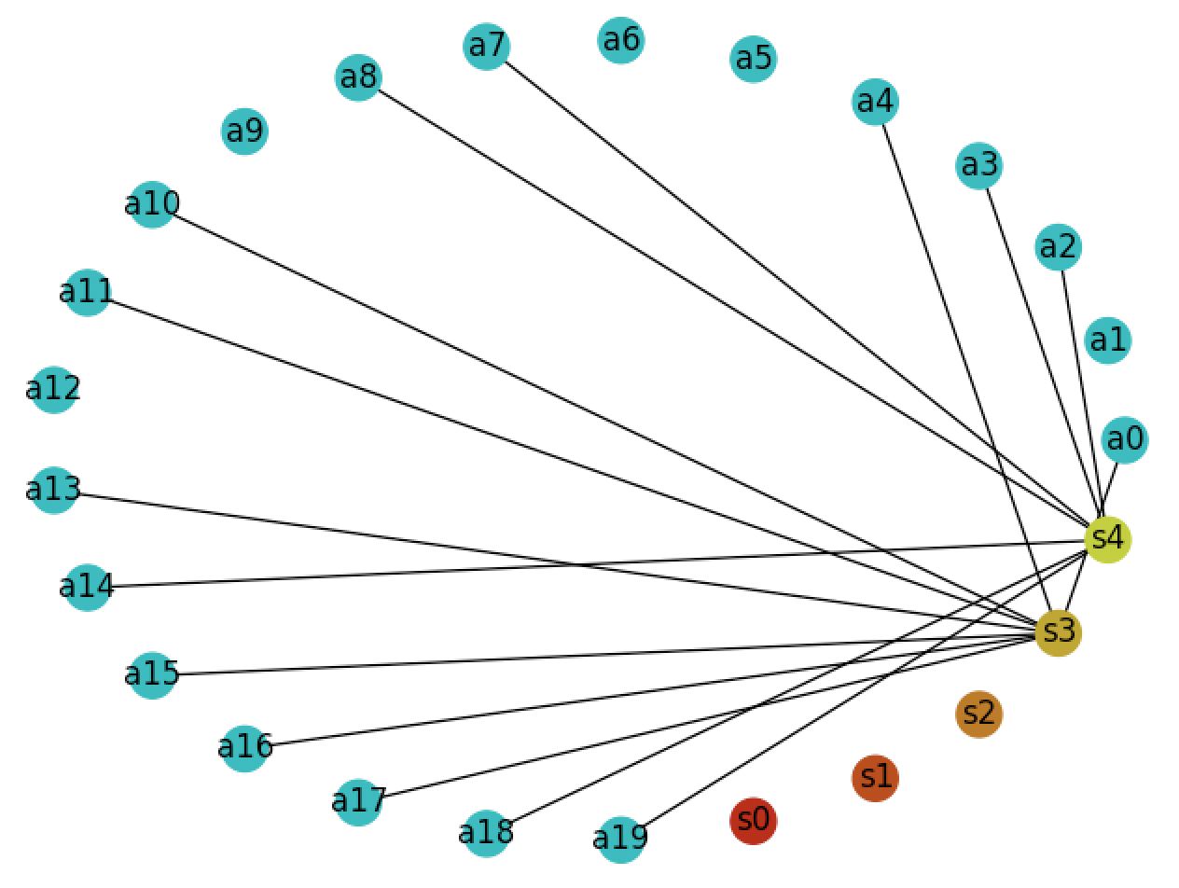
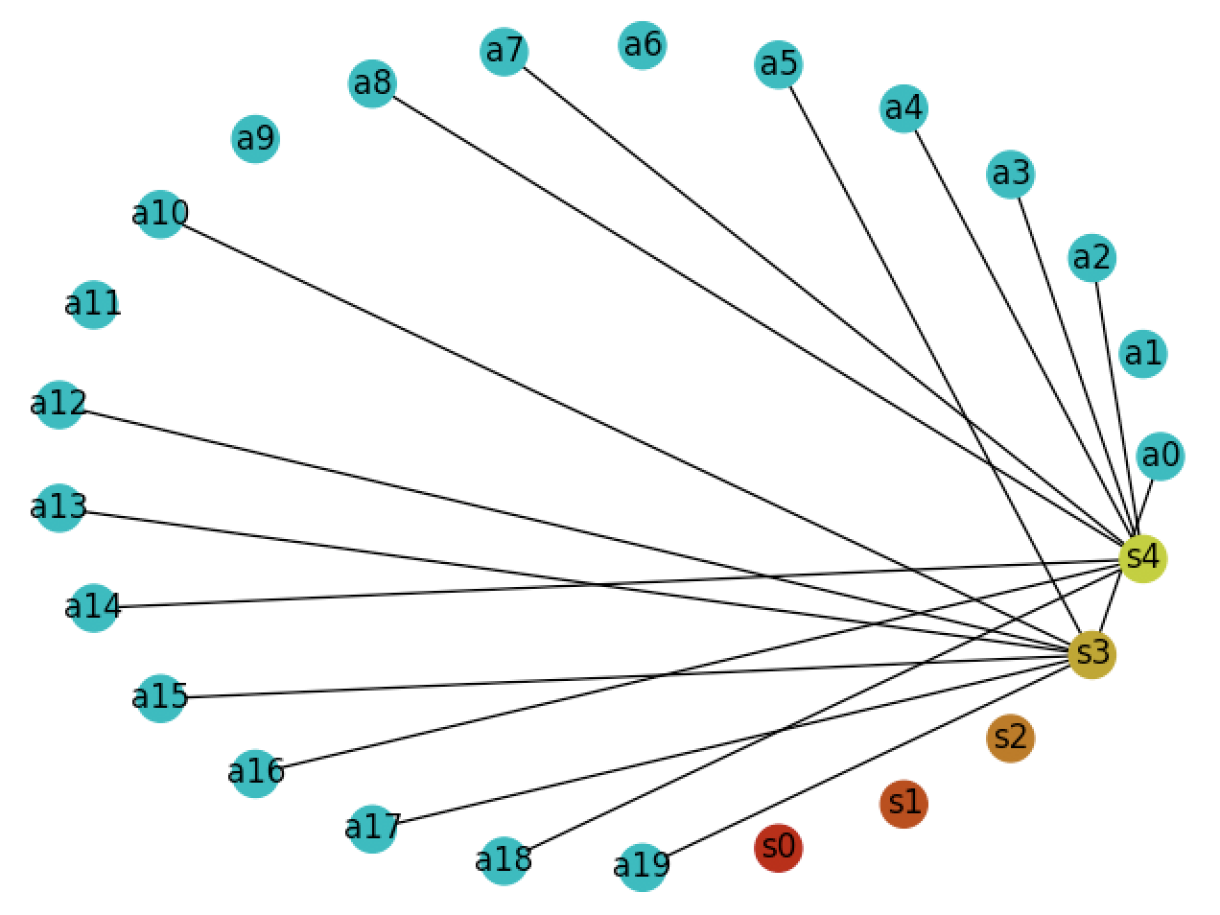
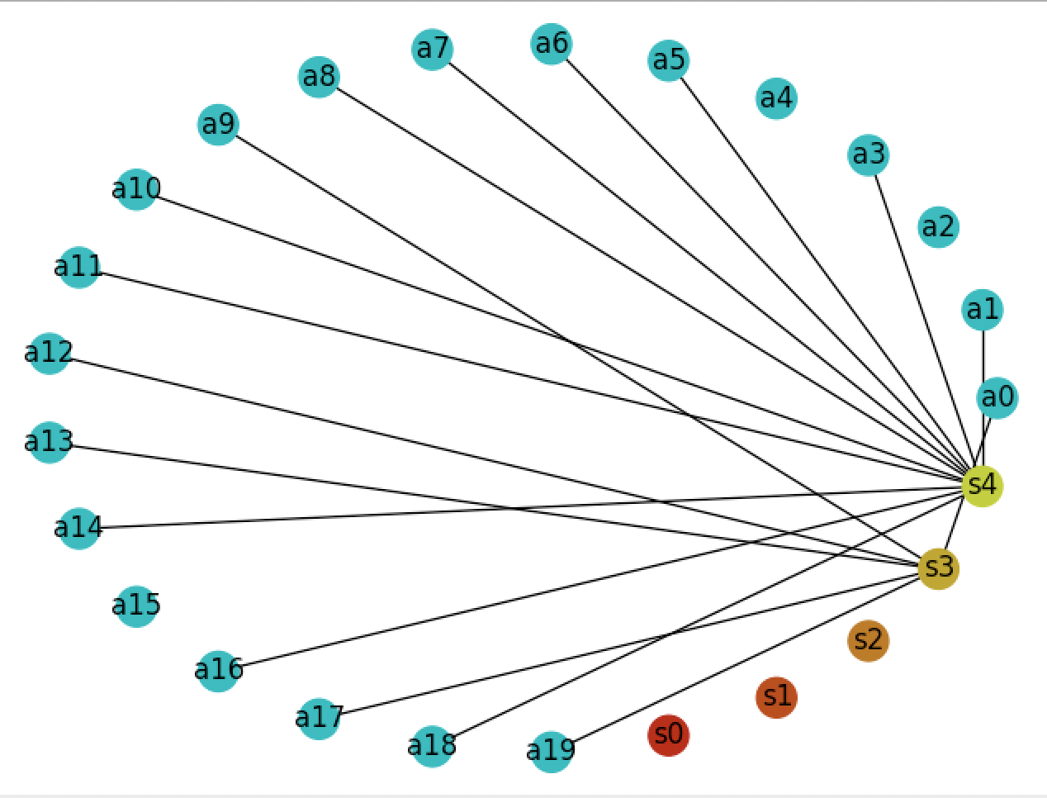
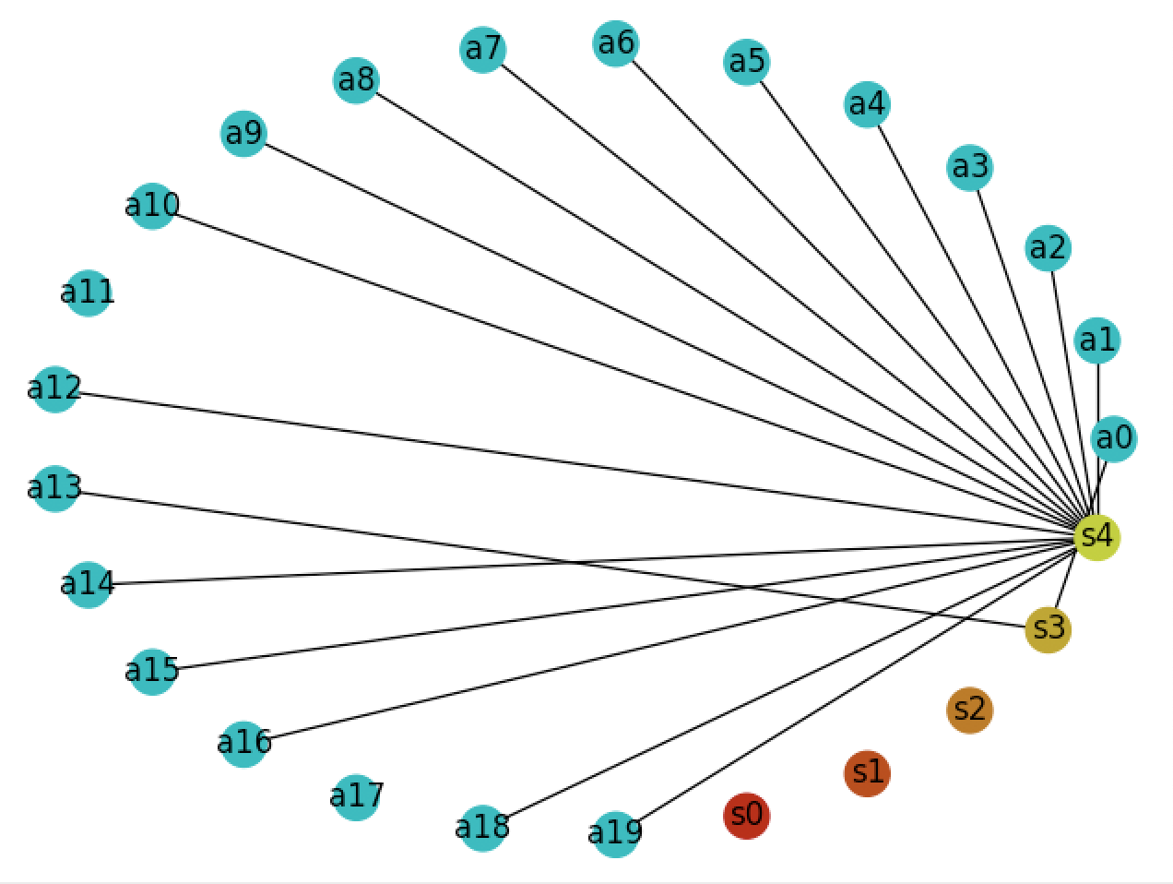
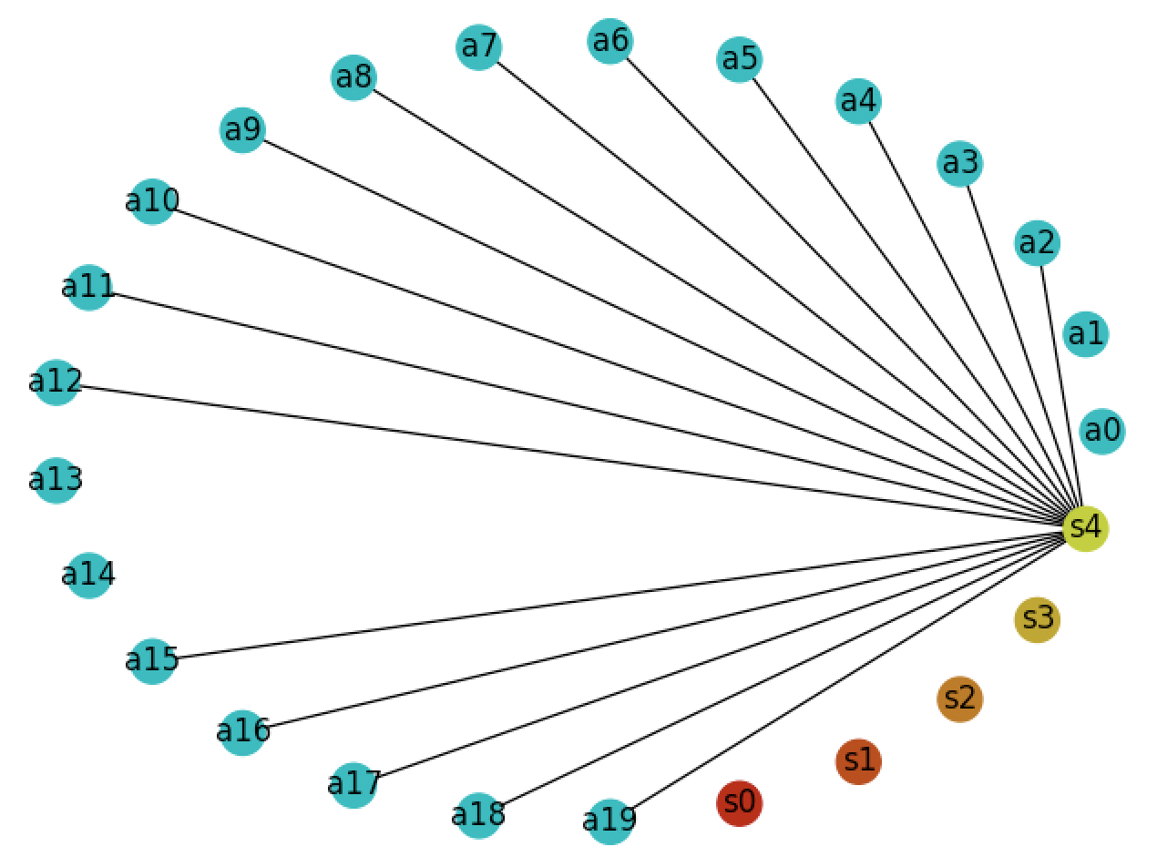
BGF Evolves over Time
...
Best site
chosen
Notes:
We need a way to represent the way the BGF changes over time. The DTMC provides this representation.

Slide 9
Graph Definition
Edge Set and Vertex Set

Slide 10
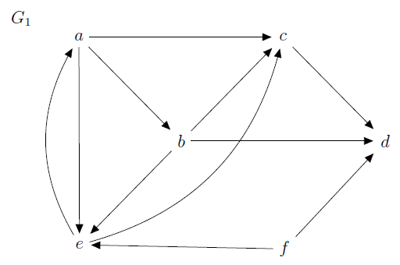
Graph Definition
A graph consists of the nonempty set V (of vertices or nodes) and a set E of edges
What are the sets V and E for the graph below?

Slide 11
Graph Definition
A graph consists of the nonempty set V (of vertices or nodes) and a set E of edges
What are the sets V and E for the graph below?
V = {a, b, c, d, e, f}
E = {(a,b), (a,c), (a,e),
(b,c), (b,d), (b,e),
(c,d), (e,a), (e,c),
(f,d), (f,e)}

Slide 12
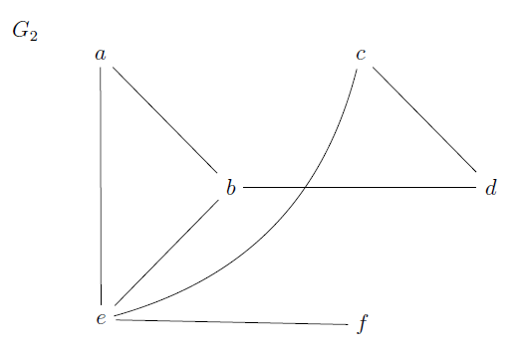
Graph Definition
A graph consists of the nonempty set V (of vertices or nodes) and a set E of edges
What are the sets V and E for the graph below?

Slide 13
Graph Definition
A graph consists of the nonempty set V (of vertices or nodes) and a set E of edges
What are the sets V and E for the graph below?
V = {a, b, c, d, e, f}
E = {{a,b}, {a,e}, {b,d},
{b,e}, {c,d}, {e,c},
{f,e}}

Slide 14
Graph Definition
A graph consists of the nonempty set V (of vertices or nodes) and a set E of edges
E can be all directed edges or
all undirected, not a mix of both

Slide 15
Graphs: Directed vs. Undirected
Consider graphs G₁ and G₂: which is undirected, which is directed?
A directed edge is an ordered pair (a,b)
a
b

Slide 16
Graphs: Directed vs. Undirected
Consider graphs G₁ and G₂: which is undirected, which is directed?
A directed edge is an ordered pair (a,b)
a
b
In edge(a, b), a is the initiating vertex, b is the terminating vertex

Slide 17
Graphs: Directed vs. Undirected
Consider graphs G₁ and G₂: which is undirected, which is directed?
A directed edge is an ordered pair (a,b)
An undirected edge is an (unordered) set {a,b}
a
b
a
b

Slide 18
Graphs: Directed vs. Undirected
Consider graphs G₁ and G₂: which is undirected, which is directed?
A directed edge is an ordered pair (a,b)
An undirected edge is an (unordered) set {a,b}
a
b
a
b
Note that {a,b} can be thought of as (a,b) and (b,a)

Slide 19
Special Graphs

Slide 20
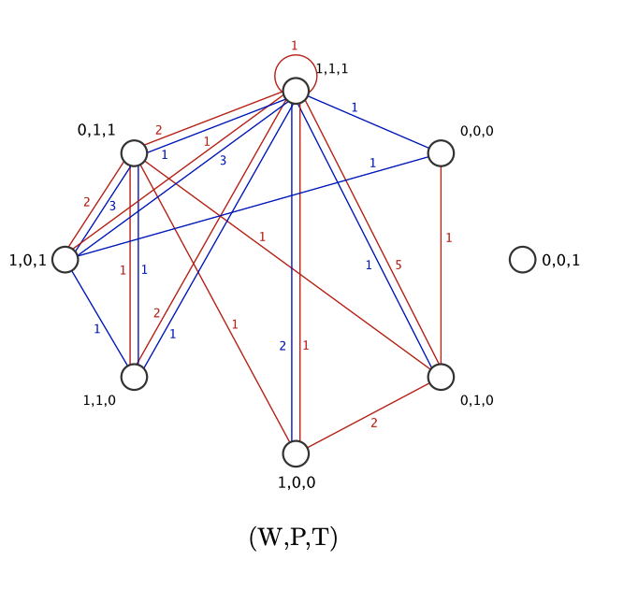
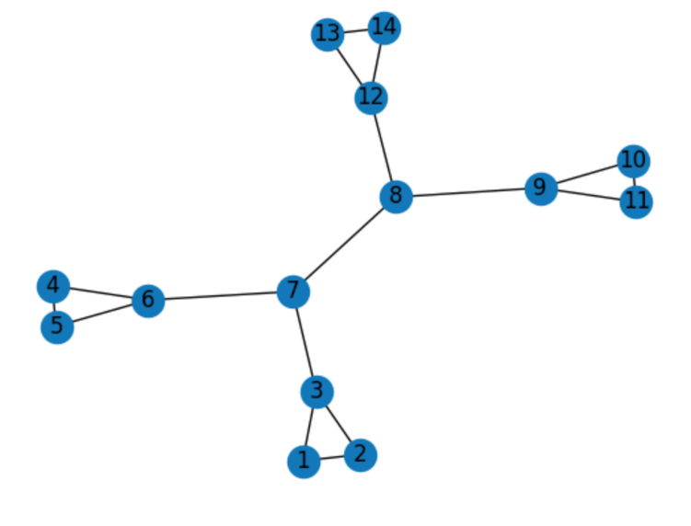
Graphs: Simple (§10.1, definition buried between def 1 and def 2)
A simple graph is a graph where
no two edges connect the same pair of vertices and
there are no self loops
Simple
Not Simple

Slide 21

Graphs: Multigraph (§10.1, definition buried between def 1 and def 2)
A multigraph is a graph that has multiple edges that connect the same pair of vertices
We won’t use multigraphs, but they are very useful in computer science

Slide 22
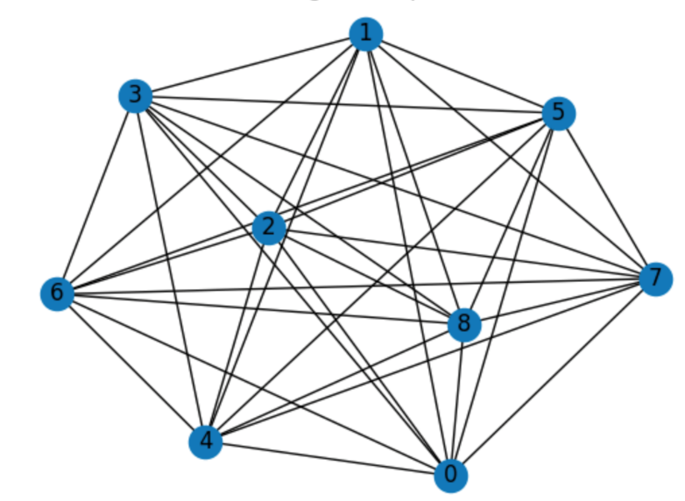
Graphs: Complete (§10.2.3)
A complete graph is a simple graph where there is an edge between every pair of vertices
Complete
Not Complete

Slide 23
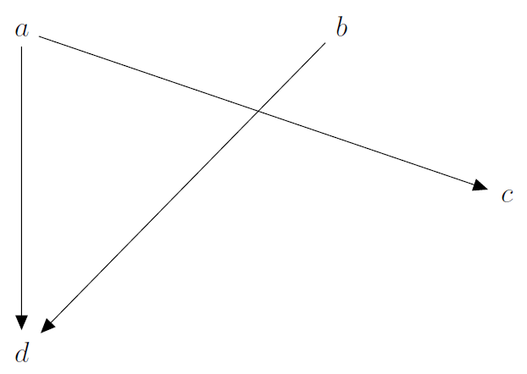
Graphs: Bipartite (Def 1 §10.2.4)
A simple graph is called bipartite if its vertex set can be partitioned into two disjoint sets V₁ and V₂ where every edge connects a vertex from V₁ to a vertex in V₂
edges between
vertices in
partition 1 …
V₁
… and
vertices from
partition 2
V₂

Slide 24
Weighted Graph
A weighted graph assigns a number to each edge
Think of the number as the distance between vertices, the time between vertices, or the strength of connection between vertices.
What is the shortest path from a to c?
3
1
1
2
1
5
4

Slide 25
Adjacent and Incident

Slide 26
Terms from Homework 16a
On Homework
Also Important
Minimum path
Path relation
Reachable
Path
Simple path
Cycle/circuit
Simple cycle
Connected, strongly connected, weakly connected
Incident
Initiating vertex
Out degree, in degree, degree
Adjacent to, from, with
Special graphs
Complete
Cycle
Bipartite

Slide 27
Adjacency and Incidence: Undirected Graphs (Def 1 §10.2.2)
Which vertices are adjacent with b?
What are the incident edges of b?
• adjacent applies to vertices
• incident applies to edges

Slide 28
Adjacency and Incidence: Undirected Graphs (Def 1 §10.2.2)
Which vertices are adjacent with b?
What are the incident edges of b?
• adjacent applies to vertices
• incident applies to edges
adjacent with b = {a, d, e}
incident edges = {{b,a}, {b,d}
{b,e}}

Slide 29
Adjacency and Incidence: Undirected Graphs (Def 1 §10.2.2)
Which vertices are adjacent with b?
What are the incident edges of b?
adjacent with b = {a, d, e}
incident edges = {{b,a}, {b,d}
{b,e}}
{b,a} or {a,b} because order doesn’t matter for undirected graphs

Slide 30
Adjacency and Incidence: Directed Graphs (Def 4 §10.2.2)
Which vertices are adjacent to a?
Which vertices are adjacent from a?
What are the incident edges of a?

Slide 31
Adjacency and Incidence: Directed Graphs (Def 4 §10.2.2)
x
a
Which vertices are adjacent to a?
Which vertices are adjacent from a?
What are the incident edges of a?
x
a

Slide 32
Adjacency and Incidence: Directed Graphs (Def 4 §10.2.2)
• adjacent applies to vertices
• incident applies to edges
Which vertices are adjacent to a?
Which vertices are adjacent from a?
What are the incident edges of a? (Ignore direction)

Slide 33
Adjacency and Incidence: Directed Graphs
Which vertices are adjacent to a?
Which vertices are adjacent from a?
What are the incident edges of a?
• adjacent applies to vertices
• incident applies to edges
adjacent to a = {e}
adjacent from a = {b, c, e}
incident edges = {(e,a),(a,b),(a,e),(a,c)}
Incident edges of a are edges that have a as the terminal vertex

Slide 34
Degree

Slide 35
Degree: Undirected Graphs (Def 2 §10.2.2)
The degree of a vertex is the number of edges incident with it
What is the degree of b, denoted as deg(b)?

Slide 36
Degree: Undirected Graphs (Def 2 §10.2.2)
The degree of a vertex is the number of edges incident with it
What is the degree of b?
1
degree of b = 3
2
3

Slide 37
Degree: Directed Graphs (Def 2 §10.2.2)
For directed graphs we have two degrees: in-degree and out-degree
What is the in-degree of b?
What is the out-degree of b?

Slide 38
Degree: Undirected Graphs (Def 2 §10.2.2)
For directed graphs we have two degrees: in-degree and out-degree
What is the in-degree of b?
What is the out-degree of b?
in degree of b = 1

Slide 39
Graphs: Directed Degree (Def 5 §10.2.2)
For directed graphs we have two degrees: in-degree and out-degree
What is the in-degree of b?
What is the out-degree of b?
out degree of b = 3

Slide 40
Paths and Cycles

Slide 41
Graph Paths (Def 1 §10.4.2)
A path from vertex u and vertex v is a sequence of edges that begins at vertex u and ends at a vertex v

Slide 42
Graph Paths (Def 1 §10.4.2)
A path from vertex u and vertex v is a sequence of edges that begins at vertex u and ends at a vertex v
There is a path from a to d by following the sequence of edges (a, c), (c, d)
We call this path a,c,d
(just use the vertices as labels)

Slide 43
Graph Paths (Def 1 §10.4.2)
A path from vertex u and vertex v is a sequence of edges that begins at vertex u and ends at a vertex v
The path length is the number of edges on the path.
It is not the number of nodes
The path from a to d with edges
(a, c), (c, d) has length 2

Slide 44
Graph Paths (Def 1 §10.4.2)
A path from vertex u and vertex v is a sequence of edges that begins at vertex u and ends at a vertex v
There is a not path from d to a

Slide 45
Graph Paths: Exercise
A path from vertex u and vertex v is a sequence of edges that begins at vertex u and ends at a vertex v
How many paths are there from e to b?

Slide 46
Graph Paths: Exercise
A path from vertex u and vertex v is a sequence of edges that begins at vertex u and ends at a vertex v
How many paths are there from e to b?
Infinite! Because of the loop from a to e:
e, a, b
e, a, e, a, b
e, a, e, a, e, a, b
…

Slide 47
Graph Paths: Simple Path (Def 2 §10.4.2)
A simple path from vertex u and vertex v does not include the same edge more than once
How many simple paths are there from e to b?
Infinite! Because of the loop from a to e:
e, a, b
e, a, e, a, b
e, a, e, a, e, a, b
…
The path e,a,b is simple, because it doesn’t use the same edge twice

Slide 48
Graph Paths: Minimum Path (not in textbook reading)
A minimum path from vertex u and vertex v is a path that begins at vertex u and ends at a vertex v, which has the fewest edges possible
What are all the paths from from e to b? Which path is minimum?

Slide 49
Graph Cycles: Def 2 §10.4.2
A path with at least one edge that begins and ends at the same vertex is called a circuit or cycle
A simple cycle can’t include the same edge more than once
Cycle? Simple cycle?
a,e
a,e,a
a,e,a,e,a

Slide 50
Graph Cycles: Def 2 §10.4.2
A path with at least one edge that begins and ends at the same vertex is called a circuit or cycle
A simple cycle can’t include the same edge more than once
Cycle? Simple cycle?
a,e – not a cycle
a,e,a – simple cycle
a,e,a,e,a – cycle

Slide 51
Reachable and Path Relations

Slide 52
Reachable (Just before problem 16 in exercises after section 10.4)
Vertex u is reachable from vertex v if there is a directed path from u to v
Is f reachable from a?
Is d reachable from a?

Slide 53
Path Relation (for homework)
Given a graph G, the path relation is
The set of ordered pairs (a,b) where a and b are both vertices of G AND
There is a path from vertex a to vertex b in G

Slide 54
Path Relation (for homework)
Given a graph G, the path relation is
The set of ordered pairs (a,b) where a and b are both vertices of G AND
There is a path from vertex a to vertex b in G
The set of pairs where b
is reachable from a

Slide 55
Path Relation (for homework)
Given a graph G, the path relation is
The set of ordered pairs (a,b) where a and b are both vertices of G AND
There is a path from vertex a to vertex b in G
What is the path relation?

Slide 56
Path Relation (for homework)
Given a graph G, the path relation is
The set of ordered pairs (a,b) where a and b are both vertices of G AND
There is a path from vertex a to vertex b in G
What is the path relation?
R = {(a,b), (a,c), (a,e), (a,e), (b,c), (b,d) …}

Slide 57
Connected, Strongly Connected, Weakly Connected

Slide 58
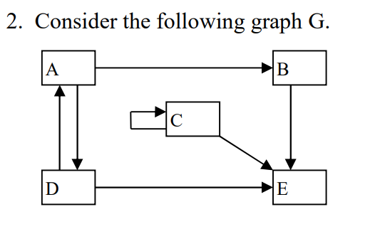
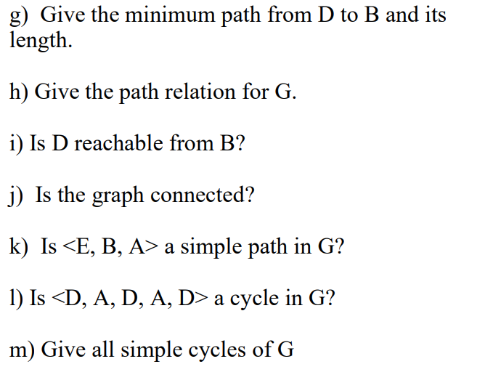
Homework
Is it strongly connected?
Is it weakly connected?

Slide 59
Homework
Is it strongly connected?
Is it weakly connected?
A graph is strongly connected if there is a directed path between any pairs of vertices.
A graph is weakly connected if there is a path (ignoring edge direction) between any pair of vertices

Slide 60
Graphs: Connectedness
An undirected graph is connected if there is a path between every pair of distinct vertices
Notes:
Is G2 connected?

Slide 61
Graphs: Connectedness
A directed graph is strongly connected if there is a (directed) path between every pair of distinct vertices
And weakly connected if there is a path in the undirected equivalent
Notes:
Is G1 strongly connected? Is it weakly connected?

Slide 62
Representing Graphs
Picture, List, Matri

Slide 63
Graph Representations
Picture: We can draw graphs, but how do we store the information in a computer?
The picture is a representation of the Vertex Set and the Edge Set

Slide 64
Graph Representations
Picture: We can draw graphs, but how do we store the information in a computer?
We can also use adjacency lists and adjacency matrices

Slide 65
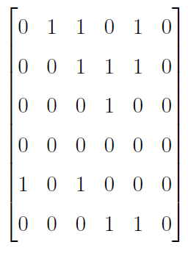
Adjacency Matrix: Directed Graph
u
v
to vertex v
from vertex u
Notes:
We’ve been doing this one with relations

Slide 66
Adjacency Matrix: Directed Graph
u
v
to vertex v
from vertex u
We’ve already used adjacency matrices with relations.
We labeled the adjacency matrix M_{R}

Slide 67
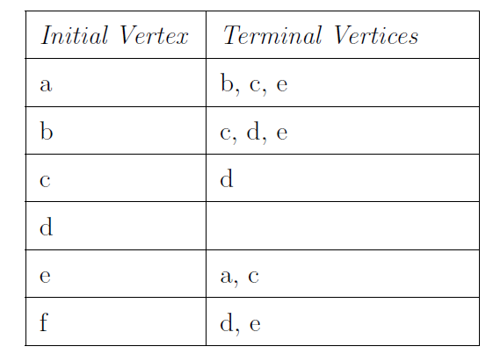
Adjacency List: Directed Graph
Graph, List, Matrix
u
v

Slide 68
Directed Graph: List, Matrix
Graph, List, Matrix

Slide 69
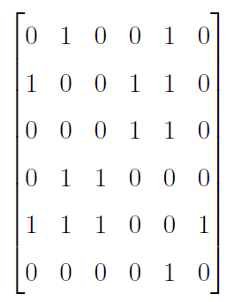
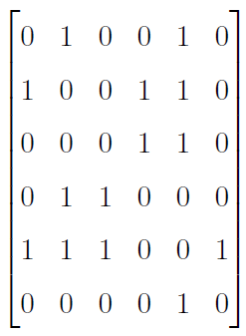
Graph Undirected: List, Matrix
Graph, List, Matrix
Symmetric Adjacency Matrix

Slide 70
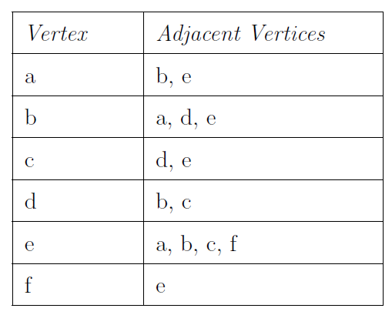
Undirected Graph: List, Matrix
Graph, List, Matrix
Note header change from
initial vertex/terminating vertices

Slide 71
Graph Undirected: List, Matrix
Graph, List, Matrix

Slide 72
Weighted Graph: Picture, List, Matrix
Graph, List, Matrix
Think of edge weights as things like
distances
times
strength of friendships
probabilities of meeting
1
6
3
5
4
2
7

Slide 73
Weighted Graph: Picture, List, Matrix
Graph, List, Matrix
Instead of just 1’s and 0’s,
use edge weights in matrix
1
6
3
5
4
2
7
Notes:
\left[\begin{array}{cccccc}
0 & 1 & 0 & 0 & 3 & 0 \\
1 & 0 & 0 & 5 & 4 & 0 \\
0 & 0 & 0 & 6 & 2 & 0 \\
0 & 5 & 6 & 0 & 0 & 0 \\
3 & 4 & 2 & 0 & 0 & 7 \\
0 & 0 & 0 & 0 & 7 & 0
\end{array}\right]

Slide 74
Weighted Graph: Picture, List, Matrix
Graph, List, Matrix
Put the edge weight next to
the terminating vertex
1
6
3
5
4
2
7
Notes:
\left[\begin{array}{cccccc}
0 & 1 & 0 & 0 & 3 & 0 \\
1 & 0 & 0 & 5 & 4 & 0 \\
0 & 0 & 0 & 6 & 2 & 0 \\
0 & 5 & 6 & 0 & 0 & 0 \\
3 & 4 & 2 & 0 & 0 & 7 \\
0 & 0 & 0 & 0 & 7 & 0
\end{array}\right]
\begin{array}{|l|l|} \hline
\mbox{Vertex} & \mbox{Adjacent vertices, weight} \\\hline
a & (b,1),\ (e,3)\\\hline
b & (a,1),\ (d,5),\ (e,4)\\\hline
c & (d,6),\ (e,2)\\\hline
d & (b,5),\ (c,6)\\\hline
e & (a,3),\ (b,4),\ (c,2),\ (f,7)\\\hline
f & (e,7)\\\hline
\end{array}

Slide 75
Graph Representations
Memory Considerations
It is more efficient to store a graph as an adjacency list when it is sparse, that is when there are few edges (think more 0’s than 1’s in the matrix)
It is more efficient to store a graph as an adjacency matrix when it is dense, that is when there are many edges (think more 1’s than 0’s in the matrix)

Slide 76
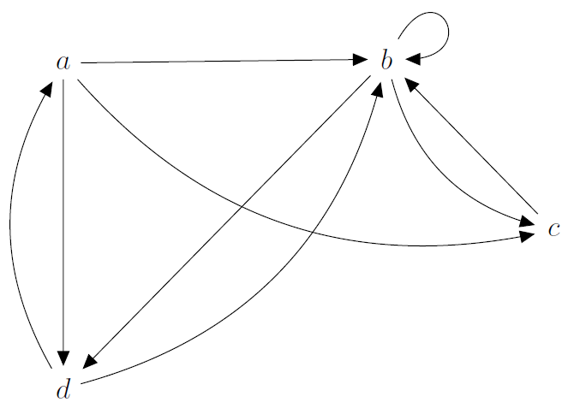
Graph Adjacency: Exercise
Create the corresponding adjacency list and matrix for the graph

Slide 77
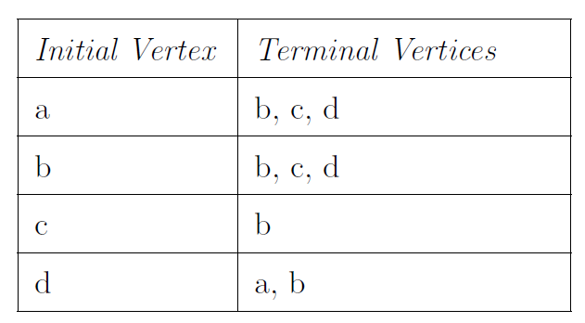
Graph Adjacency: Exercise
Create the corresponding adjacency list and matrix for the graph

Slide 78
Graph Adjacency: Exercise
Create the corresponding adjacency list and matrix for the graph

Slide 79
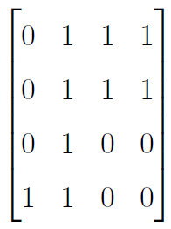
Graph Adjacency: Exercise
Create the corresponding adjacency list and matrix for the graph

Slide 80
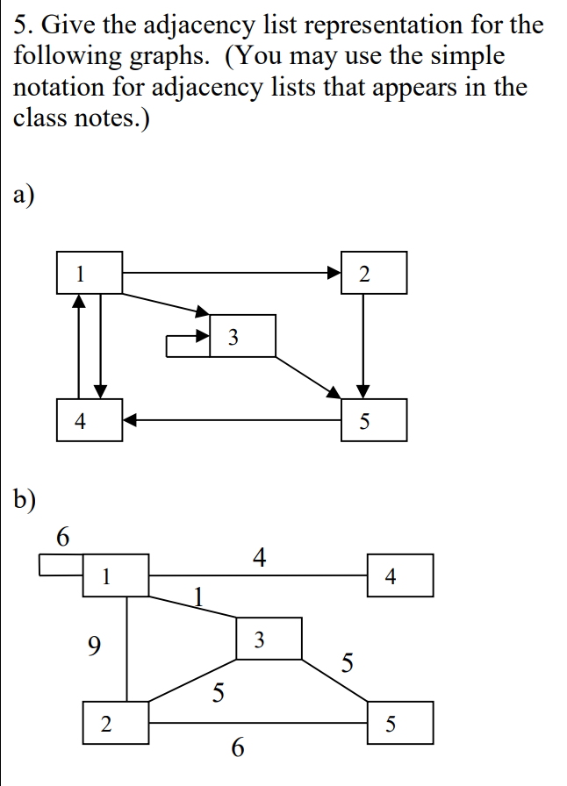
Tree Traversal

